Slide 1
Career Technical Education Safety
A guide for Career Technical Education courses.
Presented by: Nichole Spearman-Eskelsen and Paula Phelps of Salem Keizer Public Schools

Slide 2
CTE is coming to a school near you….
History –background on how CTE is making a comeback
How to have a safe and successful CTE program

Slide 3
KEY ELEMENTS for a successful CTE program
Vision/Leadership
Instructors
Industry/Internal Partnerships

Slide 4
Vision/Leadership

Slide 5
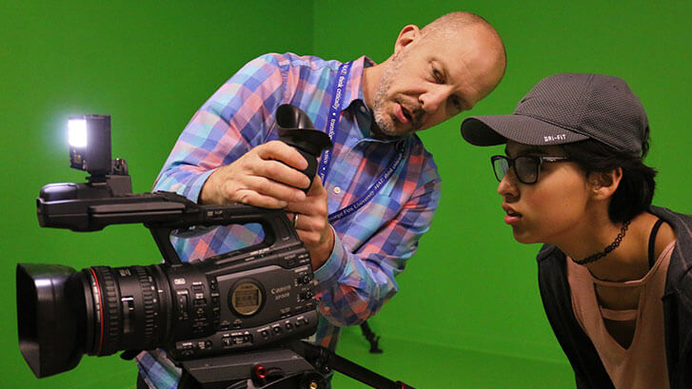
Instructors

Slide 6
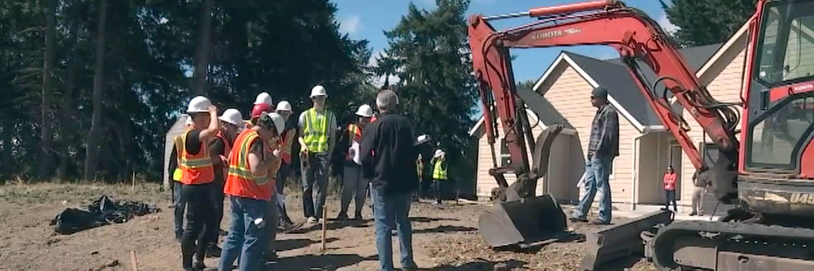
Industry/Internal Partnerships

Slide 7
Pillars of Success
Collaboration
Knowledge
Commitment
Review

Slide 8
Collaboration
Create team of subject matter experts to meet monthly
Create documents to track program/equipment/timeline process

Slide 9
TEAM MEMBERS
CTE COORDINATOR
ADMINISTRATIVE SUPPORT
FACILITIES
RISK MANAGEMENT
FINANCIAL SERVICES
TECHNOLOGY
PURCHASING
MAINTENANCE

Slide 11
Knowledge
Mutual understanding of program equipment and goals
Mutual understanding of safety protocols and legal requirements

Slide 12
Why a deep fryer??
This Photo by Unknown author is licensed under CC BY-SA.

Slide 13
Commitment
All participants committed to student success
All participants committed mutually agreed upon protocols and processes

Slide 14
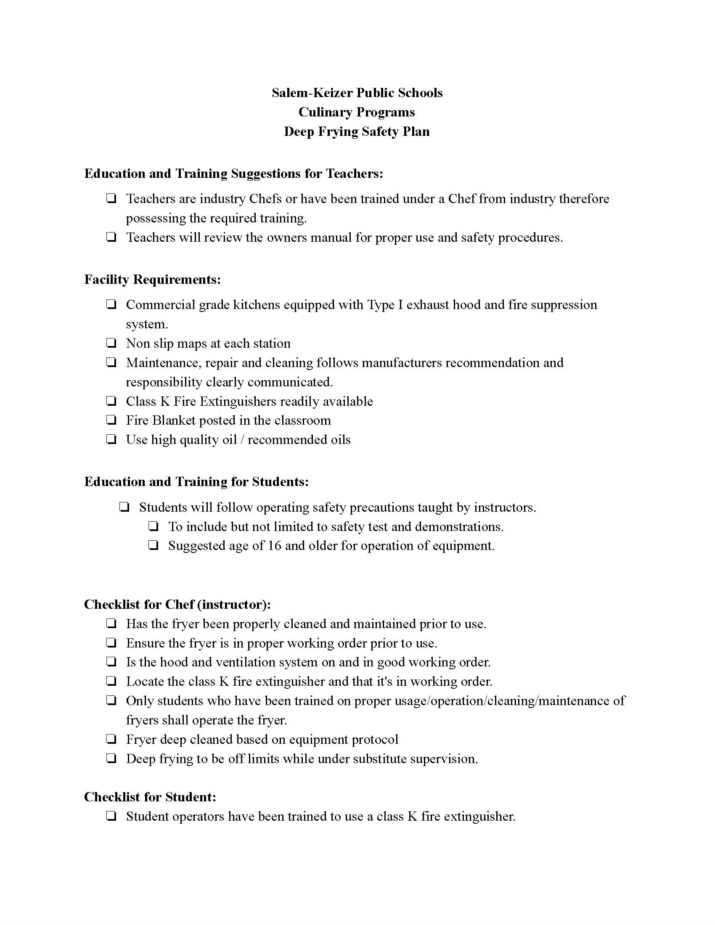
Written Safety Plan

Slide 15
Review
Review the Safety Plan in action
Celebrate success

Slide 16
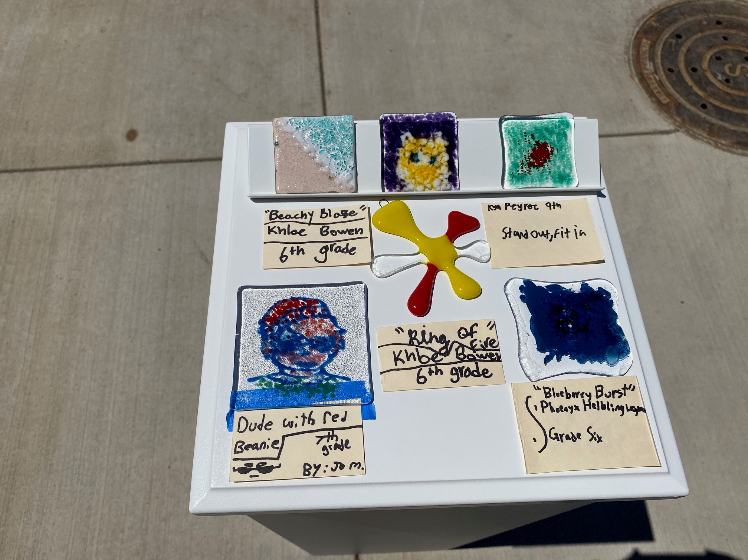
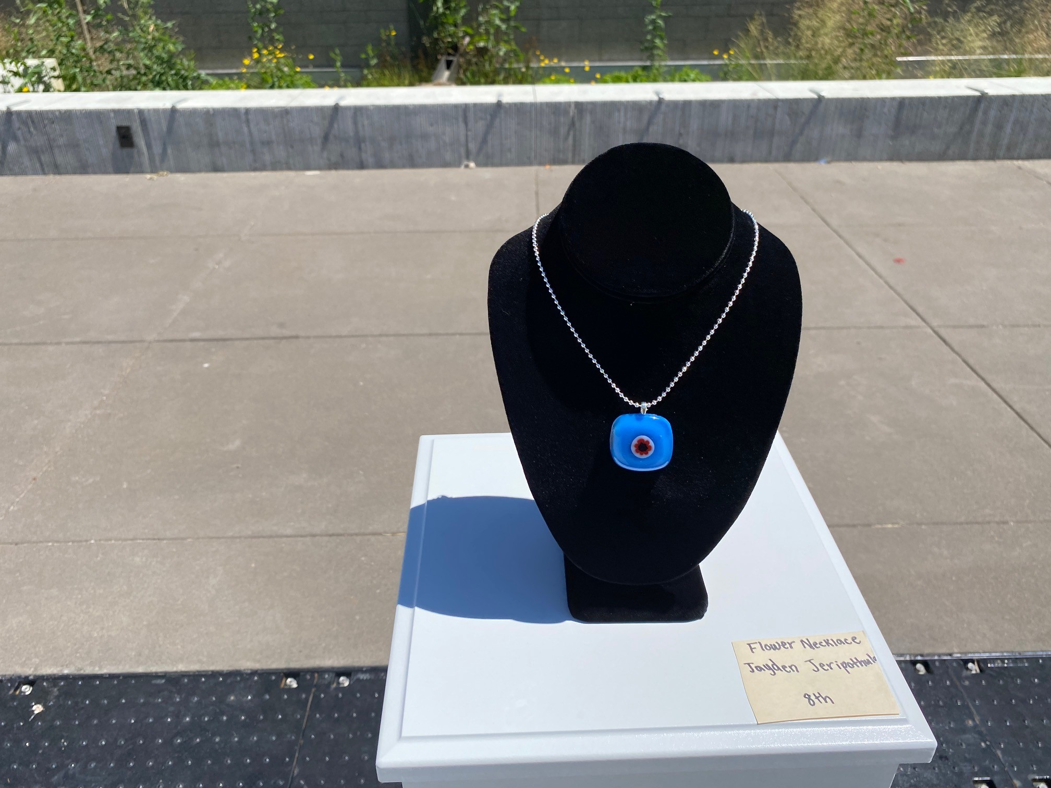
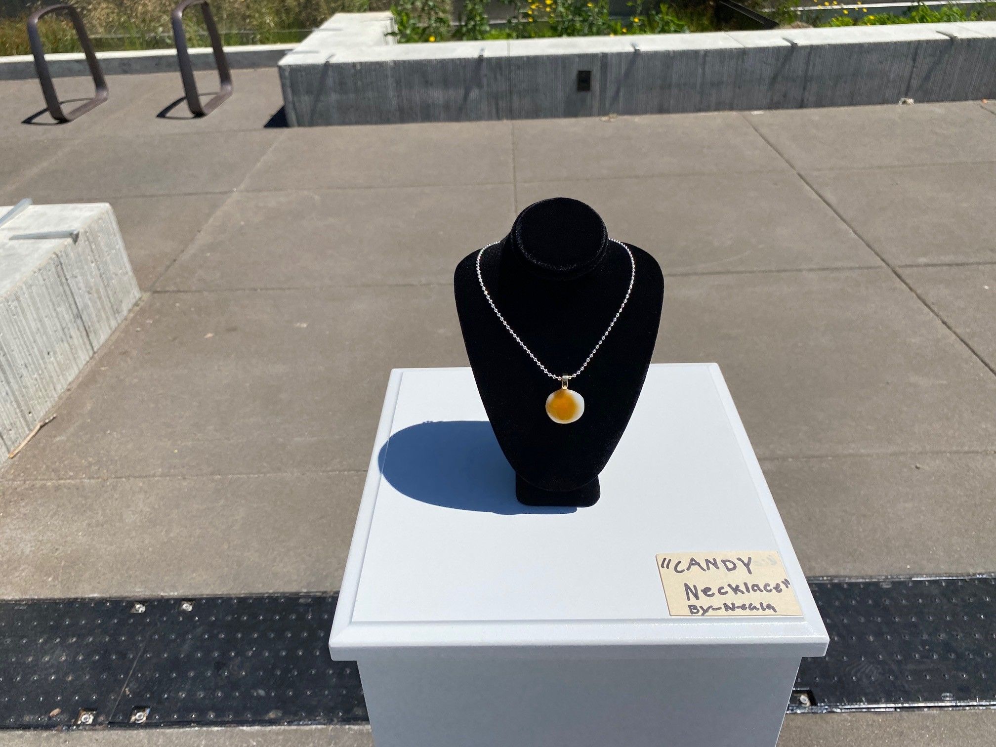
Celebration of CTE programs

Slide 17
What's Next
Reactive to Proactive

Slide 18
FUTURE PLANS
JOINT TRAINING
PRE-APPROVAL PROCESS
STUDENT SAFETY COMMITTEES
BUILD LONG TERM RELATIONSHIPS

Slide 19
INDUSTRY RECOGNIZED CREDENTIALS
Oregon Department of Education : Industry Recognized Credentials : High Quality Programs of Study : State of Oregon

Slide 20
COMMUNITY COLLEGE PARTNERSHIPS
https://go.roguecc.edu/department/workforce-training/osha-training
https://www.chemeketa.edu/programs-classes/program-finder/apprenticeship/pre-apprenticeship-program/

Slide 21
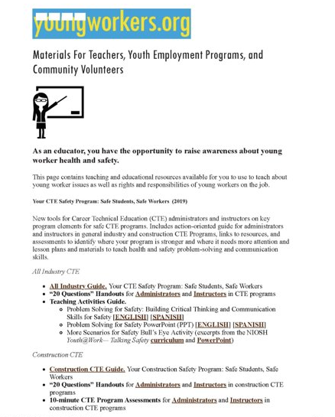
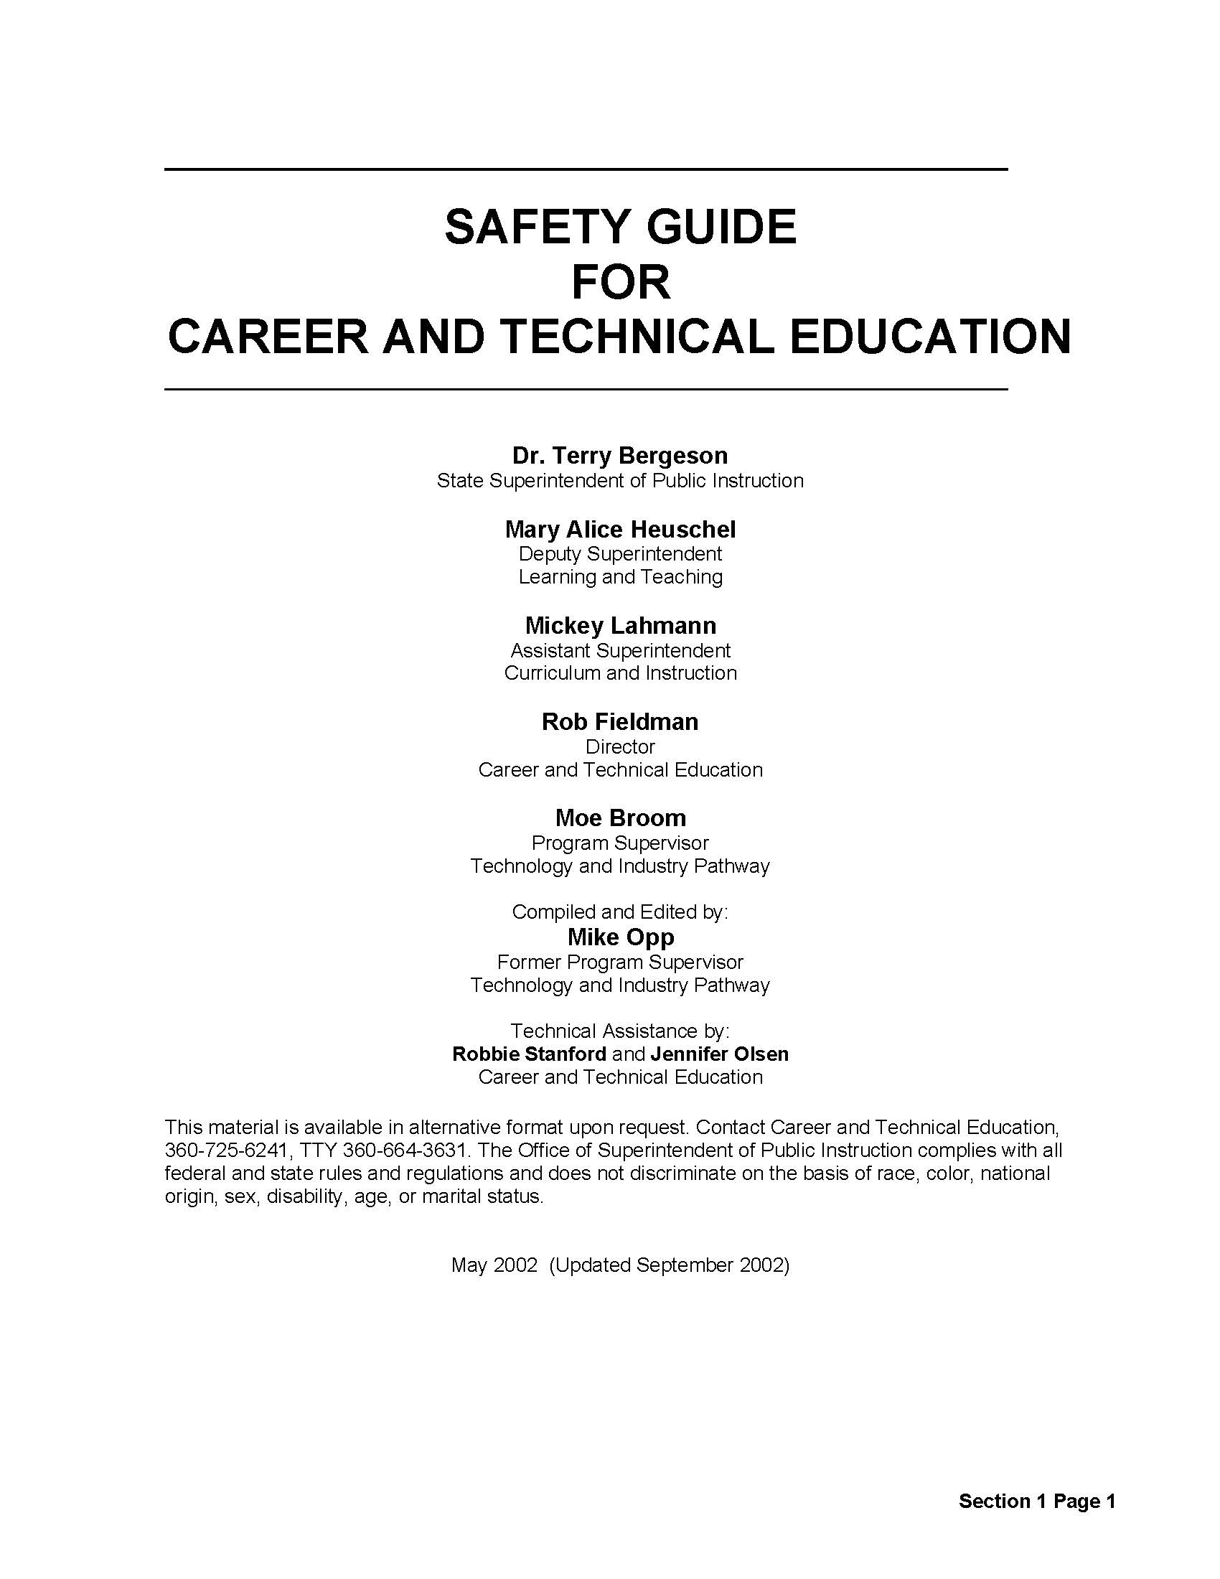
AVAILABLE RESOURCES
https://osha.oregon.gov/Pages/topics/young-worker.aspx
https://youngworkers.org/our-materials/teachers/
https://www.cdc.gov/niosh/docs/2004-101/pdfs/safe.pdf
https://osha.oregon.gov/Pages/topics/young-worker.aspx

Slide 22
CONTACT INFO
We are happy to share resources and be thought partners with you.
Nichole Spearman-Eskelsen/ spearman-eskelsen_nichole@salkeiz.k12.or.us/
503.399.1990
Paula Phelps/ phelps_paula@salkeiz.k12.or.us
503.399.3060

